Slide 1
BOOTH MULTIPLICATION

Slide 2
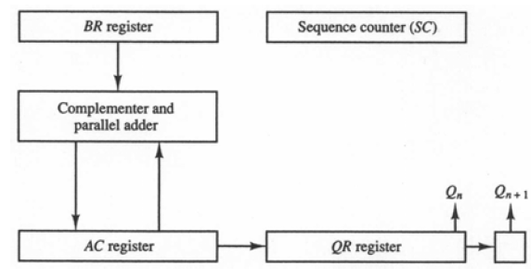
Description and Hardware for Booth Multiplication
QR multiplier
Q_{n} least significant bit of QR
Q_{n+1} previous least significant bit of QR
BR multiplicand
AC 0
SC number of bits in multiplier
Algorithm
Do SC times
Q_{n}Q_{n+1} = 10
AC ← AC + BR + 1
Q_{n}Q_{n+1} = 01
AC ← AC + BR
Arithmetic shift right AC& QR
SC ← SC – 1

Slide 3
Flowchart for Booth Multiplication
Multiply
Example: -9 × -13 = 117
BR = 10111, BR + 1 = 01001
Multiplicand in BR
Multiplier in QR
Comment
AC
QR
Q_{n+1}
SC
00000
10011
0
5
AC ← 0
Q_{n+1} ← 0
SC ← n
Subtract BR
01001
01001
Ashr
00100
11001
1
4
Ashr
00010
01100
1
3
= 10
= 01
10111
Q_{n}Q_{n+1}
Add BR
11001
AC ← AC + BR + 1
= 00
AC ← AC + BR
Ashr
11100
10110
0
2
= 11
Ashr
11110
01011
0
1
Subtract BR
01001
ashr (AC & QR)
SC ← SC – 1
00111
Ashr
00011
10101
1
0
≠ 0
= 0
SC
END

Slide 4
Exercise
Show the step by step multiplication process using Booth algorithm when the following binary numbers are multiplied. Assume 5-bit registers that hold signed numbers. The multiplicand in both cases is +15.
(+15) × (+13)
(+15) × (-13)

Slide 5
References
Text Book
M. M. Mano, Computer System Architecture, Prentice-Hall,2004

